Slide 1


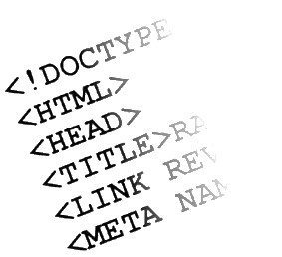

Web Design and UI Technologies
Track Overview
Telerik Software Academy
Learning & Development Team
http://academy.telerik.com

Slide 2


Table of Contents
Track Objectives & Program
Assessment
Learning Resources

Slide 3

Web Design and UI Technologies: Objectives & Program
What Topics Shall We Cover?

Slide 4
About the Track
Web Design and UI Technologies track objectives
Provide concepts, technologies and skills for web front-end development
HTML, CSS and JavaScript
Teach the basics of creating user interface
Ending with creating of web applications entirely with JavaScript and HTML

Slide 5

Track Curriculum

Slide 6

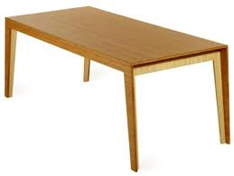

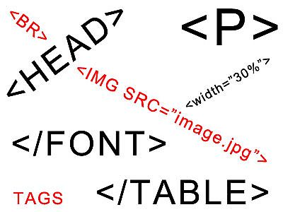

HTML Basics
Web Design Concepts and Tools
Introduction to HTML
HTML Tables
HTML Forms
Semantic HTML
HTML Basics Test

Slide 7
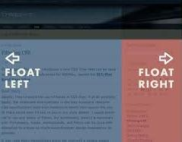
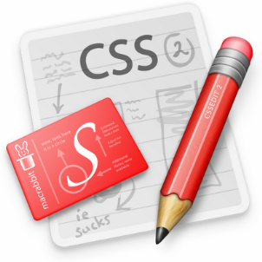



CSS Styling
CSS Basics
CSS Presentation
CSS Positioning
CSS Preprocessors
Exam Preparation
CSS Styling Exam

Slide 8



JavaScript Fundamentals
Intro to JavaScript development
Data Types and Variables
Operators and Expressions
Conditional Statements
Loops and Arrays
Functions
Exam Preparation
JavaScript Practical Exam

Slide 9
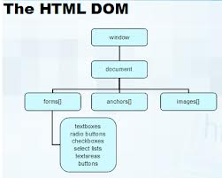
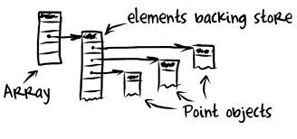
JavaScript UI
Document Object Model
DOM Manipulation
DOM Operations
JavaScript Events
jQuery Overview
Templates
Canvas API
SVG API
Exam Preparation
JavaScript Practical Exam

Slide 10


JavaScript OOP
Using Objects
Advanced Functions
JavaScript OOP
Inheritance
JavaScript Patterns
Exceptions
Good Practices
Exam Preparation
JavaScript Practical Exam

Slide 11

JavaScript Applications
Web Storages
Promises and Async Programming
HTTP and AJAX
Consuming Remote Data
Third-party APIs – Facebook, Google, etc…
JavaScript Design Patterns and SPA
App Clouds
Exam Preparation
JavaScript Practical Exam

Slide 12
SPA Applications with JavaScript
UnderscoreJS
RequireJS
MVC Architecture
MVC Frameworks
MVVM Architecture
MVVM Frameworks
Routing, Templates
Exam Preparation
Practical Exam

Slide 13

The Trainers Team

Slide 14

Trainers Team
Nikolay Kostov
Team Lead, Senior Developer and Trainer @ Telerik Corp.
Student at Sofia University
Computer Science
IT and Informatics competitions contestant
Graduate from the second season of Telerik Software Academy
Email: nikolay.kostov [at] telerik.com
Blog: http://nikolay.it

Slide 15

Trainers Team (2)
Doncho Minkov
Senior Technical Trainer @ Telerik Software Academy
Student in Sofia University
Software Engineering
Contestant in the Informatics competitions
Graduate from the first season of Telerik Software Academy
Email: doncho.minkov [at] telerik.com
Blog: http://minkov.it

Slide 16

Trainers Team (3)
George Georgiev
Technical Trainer @ Telerik Software Academy
Informatics and IT competitions contestant and winner
Graduate from the third season of Telerik Software Academy
E-mail: georgi.georgiev [at] telerik.com
Blog: http://itgeorge.net

Slide 17

Trainers Team (4)
Ivaylo Kenov
Junior Technical Trainer @ Telerik Software Academy
Graduate from the fourth season of Telerik Software Academy
Mathematical competitions contestant
E-mail: ivaylo.kenov [at] telerik.com
Champion in OOP and DSA

Slide 18

Trainers Team (5)
Pavel Kolev
Software Developer @ Telerik
The Ultimate Telerik Academy Champion
ASP.NET MVC & WebForms
Web Front-end & JavaScript Development
Mobile Applications
E-mail: pavel.kolev [at] telerik.com

Slide 19

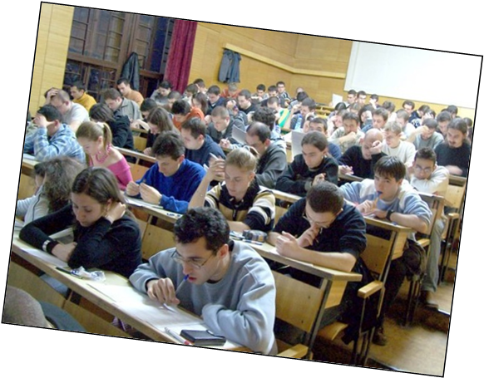
Assessment
Exams and Grades

Slide 20

HTML Basics - Evaluation
Evaluation components
Test – 65%
Attendance – 10%
Homework – 20%
Homework evaluation – 5%
3 peer reviews per homework
Bonuses
Forums activity – bonus up to 5%

Slide 21
Homework Peer Reviews
Everyone will get feedback for their homework
Everyone will give feedback for few random homework submissions
Students submit homework anonymously
Please exclude your name from the submissions!
For each homework submitted
Students evaluate 3 random homeworks
From the same topic, after the deadline
Give written feedback, at least 200 characters
Low-quality feedback → report for punishment

Slide 22
HTML Basics Test – Sample Question
You are given the following (exact) HTML code:
<div>
<p>This is\r\n
multi-line
text</p>
</div>
What will the page text look like in a modern browser?
This is multi-line text
404 – not found
This is multi-line text
This is\r\n multi-line text

Slide 23
Why HTML, CSS and JS?
HTML, CSS and JS – standard for web-based UI
Web-based applications are extremely popular
Run on anything with a browser
Windows 8 devices can run HTML, CSS and JS natively
HTML and CSS – evolving standards
JavaScript
High-level scripting language, fast to write, object-oriented, runs on client and server

Slide 24

Recommended Books

Slide 25




Recommended Books
“Designing with Web Standards”, Jeffrey Zeldman, New Riders Press, 2005, ISBN 9780321616951
"HTML & XHTML: The Definitive Guide, Sixth Edition", Chuck Musciano, Bill Kennedy, O'Reilly, 2006, ISBN 9780596527327
"CSS: The Definitive Guide, Third Edition", Eric Meyer, O'Reilly, 2006, ISBN 9780596527334
“PPK on JavaScript”, Peter Paul-Koch, New Riders Press, 2006, ISBN 9780321423306

Slide 26

Course Web Site & Forums
Register for the "Telerik Academy Forums":
Discuss the course exercises with your colleagues
Find solutions for the exercises
Share source code / discuss ideas
The HTML Basics official web site:
http://forums.academy.telerik.com/questions/front-end-development/html-css
academy.telerik.com/student-courses/web-design-and-ui/html-fundamentals/about

Slide 27
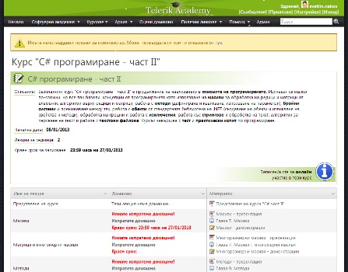
Telerik Integrated Learning System (TILS)
The Telerik Integrated Learning System (TILS)
www.telerikacademy.com
Important resource for all students
Homework submissions
Homework peer reviews
Presence cards with barcode
Reports about your results
telerikacademy.com/Courses/Courses/Details/165

Slide 28
Required Software
Software needed for this course:
Sublime Text 2/3
WebStorm 7
NodePad++
Komodo IDE
Aptana Studio
Microsoft Visual Studio *
Оr Visual Studio Express * (free versions of VS *)

Slide 29
Web Design and UI Technologies
http://academy.telerik.com

Slide 30


Free Trainings @ Telerik Academy
"Web Design with HTML5, CSS3 and JavaScript" course @ Telerik Academy
html5course.telerik.com
Telerik Software Academy
academy.telerik.com
Telerik Academy @ Facebook
facebook.com/TelerikAcademy
Telerik Software Academy Forums
forums.academy.telerik.com

